Slide 1






Activate Learning
joins
Thinking like an Engineer
Stage 2 2015/16
Dr Janet Hanson
Centre for Real-World Learning, University of Winchester
08 October 2015
janet.hanson@winchester.ac.uk

Slide 2
Aims for session
Project partners and overview of project outcomes 2014/15
Aims for 2015/16
Selecting and developing Engineering Habits of Mind
Action research – what it is and how it works
Generate a research question for implementing EHoM in your classrooms
Discuss an intervention and consider evaluation methods to report on outcomes
Outputs and timescales

Slide 3

Partners: Schools & colleges
Scotland
11 schools coordinated by Primary Engineer
North-West
12 schools co-ordinated by University of Manchester
Hampshire/W Sussex/
Berkshire/Kent
Bohunt School, The Petersfield School, New Forest Academy, Bay House School, Brune Park School, Gomer Junior School, Camelsdale Primary School, Reading College, City of Oxford College, Banbury & Bicester College, UTC Reading, Medway UTC
Midlands
JCB Academy, Rocester

Slide 4

Project background and outcomes 2014/15
2013/4 - research commissioned by Royal Academy of Engineering to uncover innovative engineering teaching - identification of 6 EHoM
2014/5 – schools and colleges recruited to help us develop proof of concept using EHoM
July 2015 – 8 presentations, 10 reports, 1 video, website with links to resources, poster
Autumn 2015/6 – additional schools and colleges recruited for a second round of EHoM development.

Slide 5
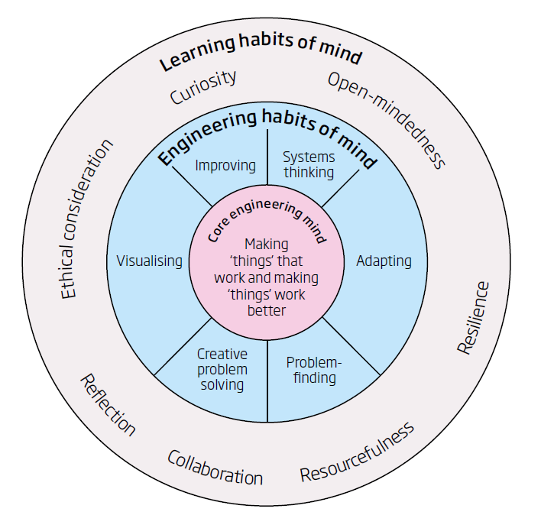
2014/15 Teachers’ EHoM RQs
Sharon: (Science) If I provide a simple improving template for students they will become more independent in improving and generating their own feedback & targets?
Ian: (FE) If I make use of a range practical models relating to electronic circuits, will it help my students to improve their system thinking skills?
Joe: (FE) If I teach the concept of self-efficacy/grit will my learners spend more time deliberately practising difficult maths concepts?
Jo: (Maths) If I model strategies for getting unstuck, will students improve their determination?
Martin (FE, MPA) If I introduce visualisation skills to learners, will they be prepared to take a chance on being able to think out of the box?
Noel (FE) If I specifically give feedback about 6 team working skills, will they work better as part of a team to solve problems creatively?
Hannah: (Prim) If I actively teach my year 2 children to have ideas, will they get better
at generating their own?
Lindsay: (Science) If I model how to evaluate as part of Year 7 projects, will their “improving and adapting” get better?
Paul: (D&T) If I give this STEM class much more ownership of their learning project, will that result in greater use of problem finding?

Slide 6
Outcomes 2015/16
For a selected EHoM/sub-EHoM, using an action research approach, teachers to implement and evaluate teaching activities that cultivate EHoM in their students – outcomes to include:
a report describing your activity and findings
schemes of work and lesson plans showing links to curriculum, key stage, learning outcomes etc.
resources used in teaching content/EHoM
case studies of how you have tracked the development and progression of EHoM
case studies of ways in which employers have been involved in developing EHoM.

Slide 7
How do you cultivate any habit of mind?
Understand it [its components and what it looks like when students do it]
Create the climate for it [be a role model, displays, use language which encourages it, notice it, reward it]
Teach it [choose pedagogies, materials, visitors, visits likely to encourage it, use the split-screen technique - subject+habit]
Build learner engagement [students own it]

Slide 8
Understand it
Experimenting
Evaluating
Connecting
Pattern-making
Critical thinking
Deliberate practising
Thinking out loud
Model-making
Other terms?
Tinkering
Checking and clarifying
Investigating
Generating ideas
Working in a team

Slide 9
Create the climate
Role models – talk about it in your life; bring in STEMNET ambassadors etc
Displays – exemplifying EHoM in action
Use language which encourages it – Teacher Prompts such as: ‘What does that remind you of?’; ‘What would you need to do to improve that?’
Notice it – use an Observation Schedule
Reward them – use a range of praise/school reward mechanisms]

Slide 10

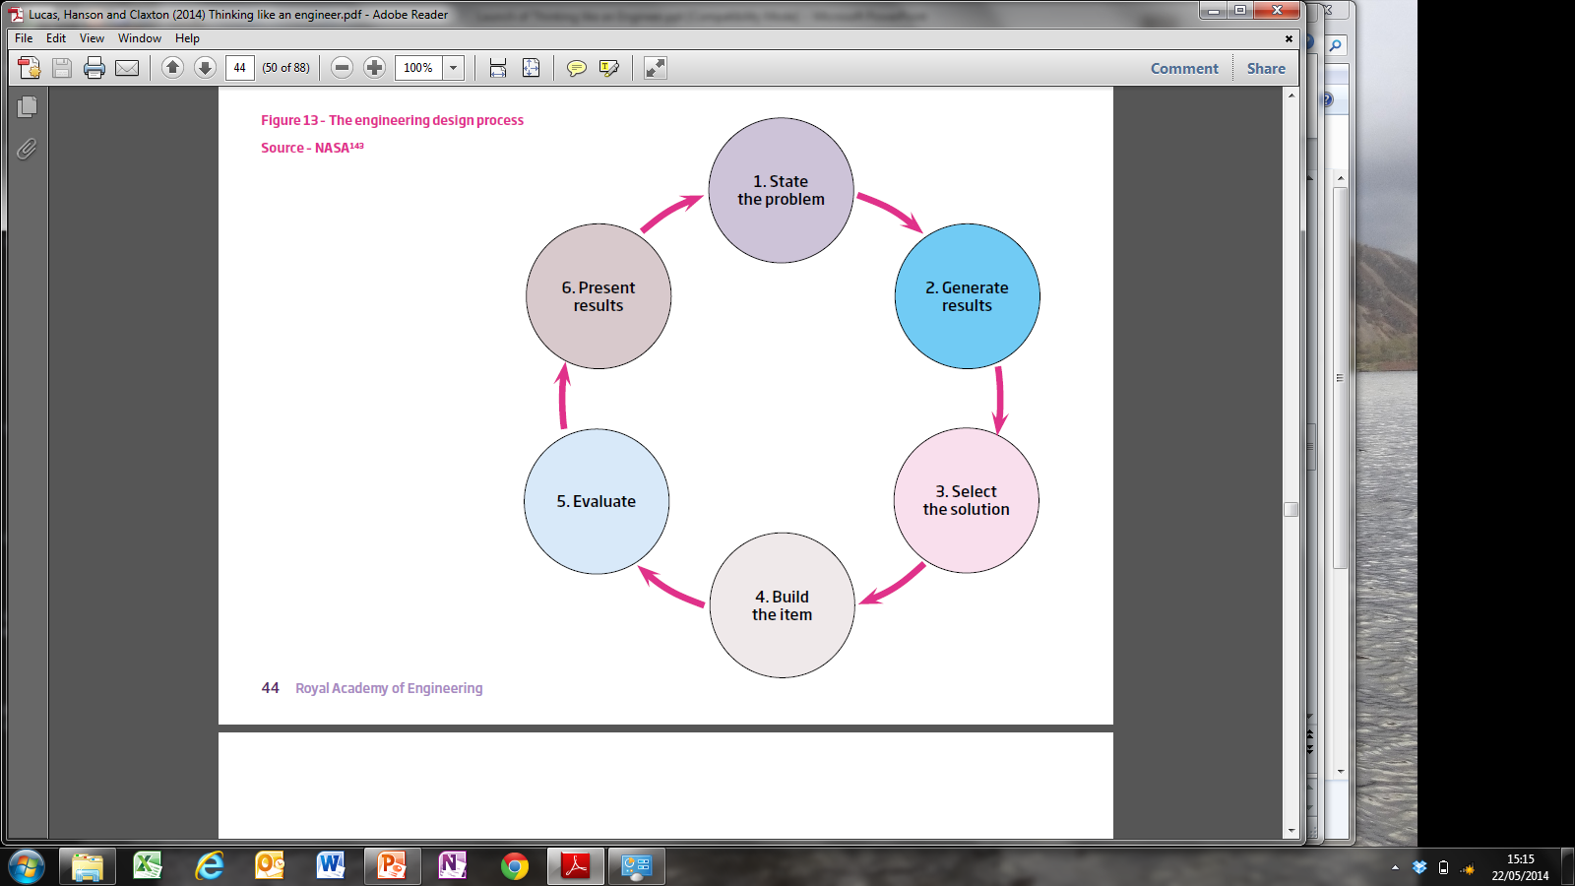

Teach it – use a ‘signature pedagogy’
What might it be for engineering?
The engineering design process
NASA
Lee Shulman (2005) Signature pedagogies in the professions Daedelus, 134, 52-59

Slide 11
Teach it
Planning, hypothesising, analysing, experimenting, reflecting, refining – developing a ‘growth mindset’
Games, computer modelling, complex
simulations, role playing
Modelling, mental rehearsal, infographics, storyboarding
Reframing,
analysing, practising in different contexts
Deep exploration of the engineering design process
Project-based learning, thinking routines

Slide 12
Teach it: Split Screen
Content | The learning process (EHoM or sub-habit)
Learning objective or conceptual understanding: What are we learning about? We are learning about climate control and endangered species | What are we learning to do or be? Students are being active in their own learning We are learning to be persuasive, have empathy and use questioning strategies.
Claxton, G. et al. (2011) The learning powered school. Bristol: TLO.

Slide 13

Build learner engagement
Make content meaningful- link the lesson to learners’ lives
Make the activity rewarding – have EHoM badges to collect or stickers for engineering inventions
Develop learner autonomy - create an e-portfolio, scan and drop stuff
Use an app to increase self-efficacy
Collaborate with other departments
to integrate approach across subjects
Capture attention with the wow factor.

Slide 14
Action Research: How it works
Practitioners improve own practice through collaborative inquiry
Spiral process of activity and reflection, with intent to act
Gather data about the impact of your activities
Tells a story in your report so others can learn from it
The teacher controls the research, not an external researcher observing the action
AR complements every-day review of teaching; not large scale with control groups
Reflect & share findings
Plan activity
Take action again, adjusting action in light of reflection
Take deliberate action, try out something new
Notice what happens, gather data & reflect
(The research)

Slide 15
The research funnel
Stimulus
Your enquiry

Slide 16
Action research as teacher enquiry
1. Stimulus
2. Hypothesis
3. Research
4. Question(s)
5. Priorities
6. The intervention
7. Evaluation methods
Your Enquiry

Slide 17
If I do x will y happen?
Your research question
What’s the EHoM ‘y’?
What’s the ‘y’?
What might you do – the ‘x’?

Slide 18
Formulating your enquiry
In pairs, share the EHoM issues that currently interest you
Use the Teacher Enquiry Funnel Diagram as a prompt
Take it in turns to talk through the processes 1- 4 on the funnel diagram
Based on the above discussion, try stating a research question in the format -
    ‘If I do X will Y happen?’

Slide 19
Decide on an intervention
You could:
Create the climate, eg:
Deliberately use different language with students
Role-model the habit yourself
Teach differently, eg:
Try out some new tools, methods or materials
Not do things you would normally do, eg: try not answering students’ basic questions but suggest three things that they can do to work things out for themselves
Build learner engagement, eg:
Give students roles which they do not normally have
‘Train’ students to coach other students
Offer students choices about their learning that they do not normally have.

Slide 20

Evaluation: or - How will you notice the changes in your learners?
Collect and
count numbers
Observations
and reflections
Collect and
analyse words
HARD
DATA
SOFT
DATA
School data:
attainment,
attendance, tests
Observation grids, photos, logs
and diaries
Surveys
Interviews and focus groups

Slide 21
Believable evaluation: triangulation
Source 1: Student survey data
Source 3: School/College data
Source 2: Your observation data
Your topic

Slide 22
Teachers’ findings 2014/15
Changing the way you do things requires planning; make sure students are clear about the task; use scaffolding at the beginning, then stand back;
Several teachers reported that students marked themselves more harshly on self report surveys after the intervention, but, as one noted: ‘they may have simply moved the goalpost of what they perceived to be a 5 in persistence’.
However, the teachers noted that they: ‘could see that their (students’) task outcomes had improved’ and ‘a 0.5 on average grade improvement per student in test score’.
Teachers also noted students’ changed behaviours:
  ‘Their mindset changed, they accepted from the start that problems needed to be worked at’
  ‘They asked intelligent questions’
  ‘Learners stayed on task and learning actually happened’.

Slide 23
Select evaluation methods
In your group consider the possible research methods in the handout Action Research Evaluation Methods
Choose up to 5 methods that seem to be useful for your action research project
Share them with the rest of the group and reduce them to just three you plan to use
Choose those which you can integrate into a busy teaching life
Also discuss how you might track and record progression in the development of an EHoM.

Slide 24
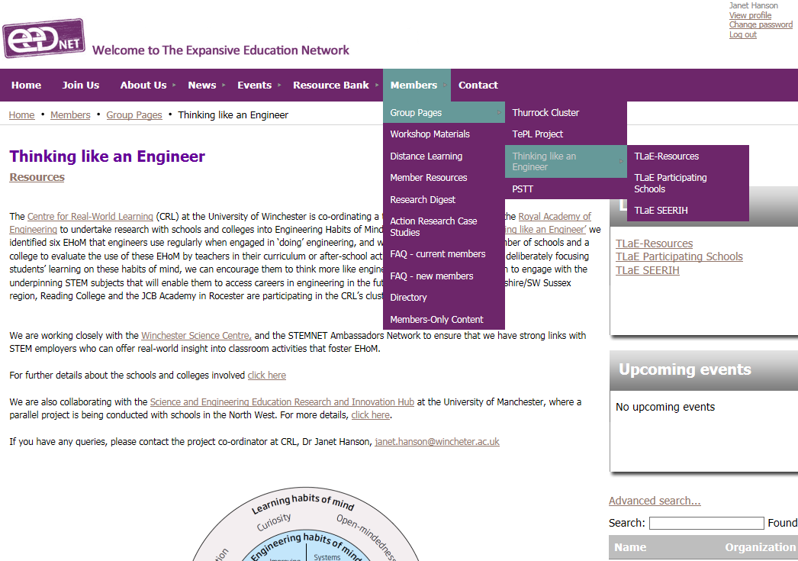
Project group pages on eedNET website

Slide 25


Gaining access to eedNET
Log in with your email and create own password
Click on Join now
button
Select membership level (Secondary/FE)
Enter your work email on next page. Your membership will be approved and you will receive a welcome message from the eedNET administrator, Naomi Irving.

Slide 26
Next steps and timescale 2015/16
Develop your action plans
Send to Janet Hanson for feedback by October 30th
(janet.hanson@winchester.ac.uk)
November – December EHoM activity underway (around 6 weeks)
09 December ‘Coaching and Check-in’ Workshop at University of Winchester 16.30-19.00
January – review your findings – time for another round of activity and review in January – February?
Late May/June dissemination conference in London (tbc)
July 6th - virtual link up with Manchester for conference within European City of Science celebrations
Internal Activate celebratory event?
Notes:
UTC Reading October holiday is 26 – 30 October
November – December EHoM activity underway (around 6 weeks) Nov 2nd – Dec 18th end of term
January – review your findings – time for another round in Jan –Feb 15 Feb – 19 Feb Feb holiday – Independent study week for Reading College
25 March End of spring term Easter 25 March -28 March
6th July is Lynne’s European City of Science in Manchester Children’s conference event - could we link up with this?
Reading College:
Term dates
2015/6
Autumn term
Teaching commences - Monday 7 September 2015
Independent study week - Monday 26 - Friday 30 October 2015
End of teaching term - Friday 18 December 2015
Spring term
Teaching commences - Monday 4 January 2016
Independent study week - Monday 15 - Friday 19 February 2016
End of teaching term - Thursday 24 March 2016
Summer term
Teaching commences - Monday 11 April 2016
Independent study week - Monday 30 May- Friday 3 June 2016
End of teaching term - Friday 1 July 2016

Slide 27

Thank you for participating
Any questions?
janet.hanson@winchester.ac.uk

Slide 28
http://www.expansiveeducation.net/TLaB
www.winchester.ac.uk/realworldlearning
www.raeng.org.uk/thinkinglikeanengineer
www.educatingruby.org
Tinker Tailor Robot Pi
https://www.youtube.com/watch?v=TRF-2g95_-k

